Slide 1
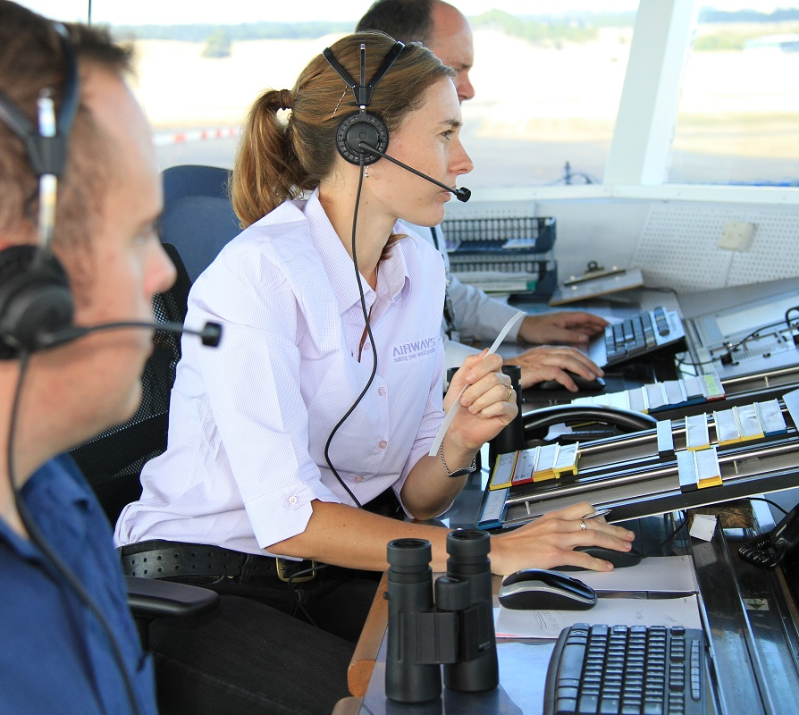
AIR TRAFFIC CONTROLLER
They speak, planes listen, and the sky obeys."

Slide 2


FATIGUE DETECTION BASED ON FACIAL AND VOCAL FEATURES USING DFNN IN AIR TRAFFIC CONTROLLER ACHARYA NAGARJUNA UNIVERSITY COLLEGE OF ENGINEERING AND TECHNOLOGY TEAM MEMBERS: UNDER THE GUIDENCE OF: 1.B.NAVEENA (Y21EC3202) Dr.Ch.D UMASANKAR M.Tech Ph.D 2.SK.MAHABOOB SUBHANI (Y21EC3251) 3.N.RAHUL (Y21IEC3201)

Slide 3
Table Of Contents
AGENDA:
Abstract
Introduction
Literature review
Problem statement
Methodology
Results

Slide 4
ABSTRACT :
Fatigue among air traffic controllers (ATCs) has become a critical issue for flight safety, particularly with the increasing volume of global air traffic. Accurately detecting fatigue is essential, as it directly influences the safety and operational efficiency of air traffic control. In this study, we propose a non-invasive approach to fatigue detection by analyzing both facial and vocal characteristics of ATCs. We first developed efficient methods for facial feature extraction, enabling us to track indicators such as "percentage of eyelid closures" and yawning frequency from video footage. Additionally, we extracted a range of vocal features from audio data, including average fundamental frequency, short-time average magnitude, short-time zero-crossing rate, harmonic-to-noise ratio, jitter, shimmer, loudness, and Mel-frequency cepstral coefficients. These facial and vocal features were transformed into temporal sequences and fed into a dynamic fuzzy neural network (DFNN). By combining these data with the Stanford Sleepiness Scale, we were able to accurately assess and predict ATC fatigue levels

Slide 5

INTRODUCTION
AIR TRAFFIC CONTROLLER :A ground-based service that directs aircraft in controlled airspace and on runways to prevent collisions, organize traffic flow, and provide critical flight information
The International Civil Aviation Organization (ICAO) has intensified its efforts to enhance the safety of air navigation systems
According to previous research fatigue is a major identifiable and preventable cause of accidents, accounting for 15% to 20% of all accidents
Fatigue can lead to changes in human physiological and psychological processes, resulting in reduced human bodily functions that can cause diseases and accidents
air traffic management Recognizing that human factors play a crucial role in air transportation, fatigue among ATCs has become a focal point of attention.
Previous research has identified three main methods for fatigue detection they are described below

Slide 6





methods
1.physiological- indicator-based detection
EEG
ECG
EOG
FNIRS
2.Questionnaire-based detection
3.Computer-vision based detection
CNN
RNN
SVM
First Skill
Second Skill
Third Skill
Conclusion

Slide 7
LITERATURE REVIEW:
SL NO | PUBLISHED YEAR | TITLE OF SAMPLE PAPERS | AUTHOR | TECHNIQUES | ACCURACY | LIMITATIONS
1. | 2021 | Real-Time Driver Drowsiness Detection Using Deep Learning Techniques | D.Dhamija. R.Agarwal A.D.Cheok | CNN,SVM | 92.5% | performance degrades under poor lighting conditions
2. | 2022 | "Developing a Deep Neural Network for Driver Fatigue Detection Using EEG Signals Based on Compressed Sensing | Sobhan Sheykhivand, Tohid Yousefi Rezaii, Saeed Meshgini, Somaye Makoui, Ali Farzamnia | DNN | 92% | The study's reliance on EEG signals requires the use of specialized equipment, which may not be practical for all real-world applications.

Slide 8
SL NO | PUBLISHED YEAR | TITLE OF SAMPLE PAPERS | AUTHOR | TECHNIQUES | ACCURACY | LIMITATIONS
3. | 2023 | Hybrid CNN-LSTM Model for Driver Drowsiness Detection Using Video and Physiological Signals | J.Wang H.Li Y.Zhang | CNN-LSTM | 94.2% | requires multiple sensors(camera+physiological sensors)
4. | 2024 | Lightweight CNN Model for Driver Drowsiness Detection Using Facial Landmarks | A.Gupta P.Kumar R.Singh | CNN | 89.8% | 1.Lower accuracy for individuals with glasses or facial obstructions 2.Not robust in varying illumination conditions

Slide 9
SL NO | PUBLISHED YEAR | TITLE OF SAMPLE PAPERS | AUTHOR | TECHNIQUES | ACCURACY | LIMITATIONS
5. | 2016 | A Smartphone-Based Driver Fatigue Detection Using Fusion of Multiple Real-Time Facial Features | Y. Qiao, C. Song S. Shimamoto | SVM | 83.5% | specific accuracy metrics are not provided; the effectiveness may vary under different lighting conditions and with diverse facial features
6. | 2024 | Air Traffic Controller Fatigue Detection Based on Facial and Vocal features using LSTM | Zhoushengh huang | Bi-LSTM+GRU | 95.12% | performance degrades under poor lighting conditions

Slide 10
PROBLEM STATEMENT:
The proposed method aims to improve the accuracy of fatigue detection by combining facial and vocal features, which are non-invasive . The study validates the effectiveness of the proposed method, achieving a recognition accuracy rate of 96 the test audio and video datasets. This approach provides a theoretical basis for using combined facial and vocal features in detecting fatigue and can be applied for real-time applications to prevent air traffic incidents caused by ATC fatigue.

Slide 11
METHODOLOGY:
A.DATA ACQUISATION:
Two types of data are collected non-invasively from Air Traffic Controllers (ATCs):
Video recordings for facial features.
Audio recordings for vocal features.
The Stanford Sleepiness Scale (SSS) was used for ground truth labeling of fatigue levels.
B.FEATURE EXTRACTION:
Face and landmark detection: Performed using MTCNN for initial face detection and MediaPipe for extracting 468 facial landmarks.
Eye Features: Eye Aspect Ratio (EAR)
Mouth Features: Mouth Aspect Ratio (MAR)
C. VOCAL FEATURE EXTRACTION:
Mel-Frequency Cepstral Coefficients (MFCCs):

Slide 12
D.FEATURE VECTOR FORMATION:
All extracted features are compiled into a 21-dimensional feature vector per video/audio segment
E.FATIGUE LEVEL LABELLING:
Each segment is labeled using the Stanford Sleepiness Scale (SSS) ranging from 1 (most alert) to 7 (most fatigued). Both binary (awake/fatigued) and multiclass classification are supported.
F. FATIGUE DETECTION USING DFNN:
Handles uncertainty and gradual transitions between fatigue states more effectively than deterministic models.

Slide 13
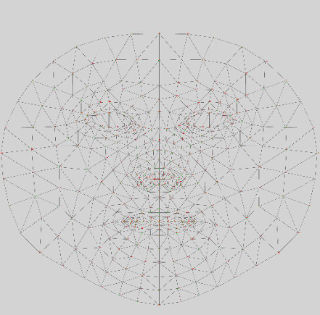
FACIAL AND VOCAL FEATURES:
Facial features:
All facial features are extracted from the library named media pipe or Dlib
Dlib library consist only 68 facial landmarks ,it is a default face detector
Media pipe library consist of 468 facial landmarks .mediapipe is more stable than Dlib ,
Mediapipe consist of 3 dimensional coordinates that are estimated

Slide 14
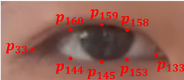

FACIAL AND VOCAL FEATURES
Facial features
1.Eye features
Eye blink detection plays a crucial role in monitoring operator fatigue, including that of ATCs. To pinpoint the blinking characteristic
These landmarks define the feature points around the eyes. only six key points were used to describe the height and width of the eyes. To more accurately describe their height, we included two additional key points
With increasing fatigue, the eyes may remain closed for longer time periods; consequently, the EAR decreases.
EARL = ∥p160 −p144∥+∥p158 −p153∥+2∥p159 −p145∥ / 4∥p33 −p133∥ ,
EARR = ∥p386 −p374∥+∥p385 −p380∥+2∥p387 −p373∥ / 4∥p362 − p263∥

Slide 15
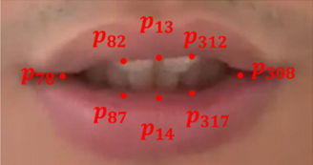
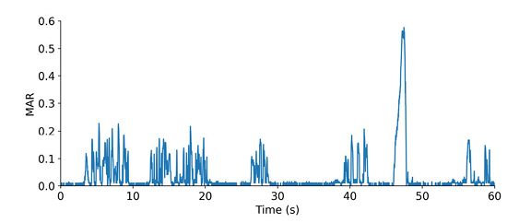
2.Mouth features
mouth features, which can be used to identify whether a person is yawning. By using MediaPipe,
the MAR is close to zero when the subject is silent and approximately 0.2 when the subject is speaking normally.
A yawning behavior is indicated when the MAR surpasses 0.4. By tracking the MAR fluctuations in real-time from the source videos.
it is possible to detect yawning. In this study, an MAR value exceeding 0.4 that persists for at least 2 s is interpreted as a yawning event, which is a recognized indicator of fatigue. Utilizing this criterion, we can quantify the total duration of yawning
MAR= ∥p82−p87∥+∥p312 −p317∥+2∥p13 −p14∥ / 4∥p78 −p308∥

Slide 16
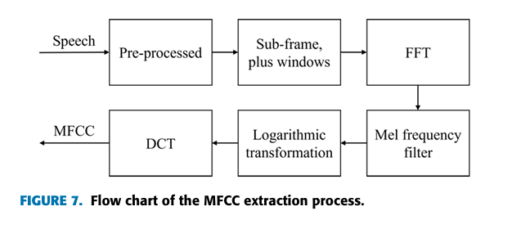

Vocal features
MFCC(Mel frequency cepstral coeffient):
The MFCC is a cepstral parameter extracted from the Mel scale frequency domain.
In speech recognition tasks, the MFCC is considered a feature vector describing the sound signal of each frame
The MFCC is a feature processing index that simulates the way in which the human auditory system processes sound and can be used to distinguish between different speakers and speech states
The formula for converting from the actual voice frequency to the Mel-frequency is as follows:
fmel=2595lg(1+ f 700 )

Slide 17
LOUDNESS:
Loudness is an indicator used to quantify sound intensity or volume. Correspondingly, fatigue can cause changes in sound intensity. By observing changes in sound loudness, the characteristics of sound under fatigue can be captured. Loudness can be defined as follows:
where L denotes the loudness of the sound (in decibels), I denotes the sound pressure level, and I0 denotes the reference sound pressure level (usually 20µPa).

Slide 18
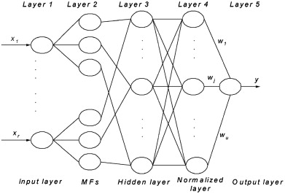
DFNN ARCHITECTURE:

Slide 19
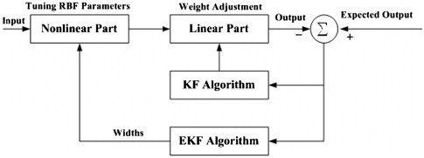
Dfnn learning model
This hybrid RBF-based DFNN with KF and EKF:
Adapts both linear weights and nonlinear parameters
Uses feedback to minimize error
Is suited for real-time, noisy, nonlinear environments
Can be used in fatigue detection, signal prediction, control systems, and dynamic pattern recognition

Slide 20
Why dfnn
DFNNs are a type of neural network that are well suited for problems that are involve:
Image classification
Object detection
Regression tasks
Classification tasks
DFNNs have the ability to:
large complex patterns
Handle high dimensional data
scale to large datasets

Slide 21
Key points:
Software used: google colab
Dataset : UTA Real-Life Drowsiness Dataset (UTA-RLDD) fold 5 [dataset link:UTA Real-Life Drowsiness Dataset (UTA-RLDD) fold 5 ]
Dataset type:videos[40 videos]
Libraries used: Mediapipe,fuzzy,tensorflow,Kaggle,opencv-python-headless, librosa, numpy ,scikit-learn
Learning model : adam optimizer

Slide 22
Adam Optimizer:
Adam Optimizer Adaptive Moment Estimation is an efficient algorithm for gradient descent, combining the 'gradient descent with momentum' and 'RMSP' algorithms for large, complex problems
Adam optimizer uses momentum and gradient descent methodologies to accelerate convergence towards minima by considering the exponentially weighted average of gradients
Adam optimizer significantly outperforms previous models in terms of training cost and performance, enhancing the quality of gradient descent
Adam Optimizer inherits the strengths or the positive attributes of the above two methods and builds upon them to give a more optimized gradient descent.

Slide 23
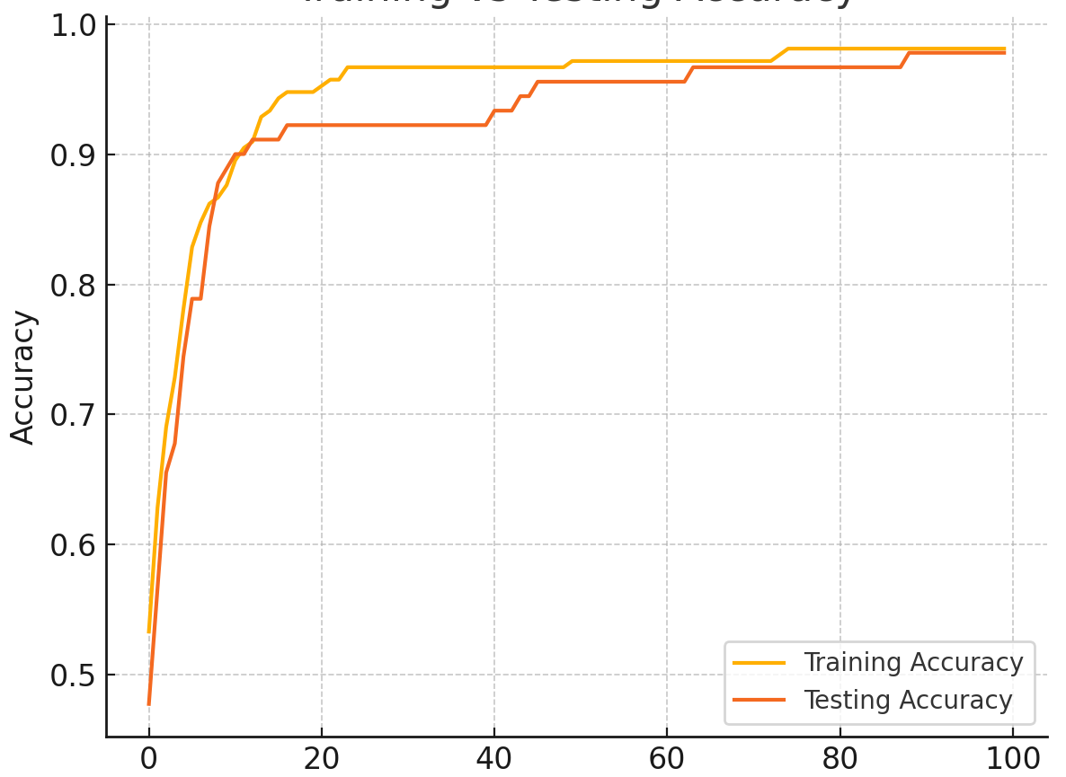
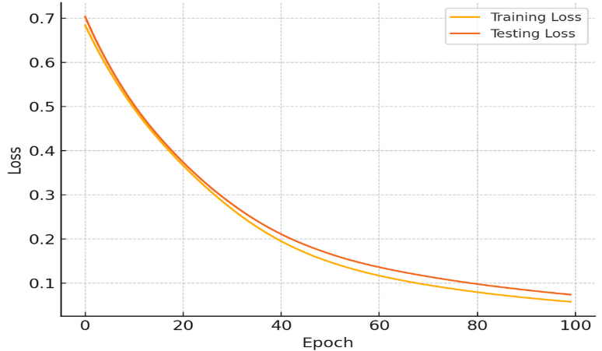
RESULTS:
Training Accuracy Vs Testing Accuracy: Training Loss and Testing Loss:
TRAINING ACCURACY:99%
FATIGUE PROBABILITY:0.13

Slide 24
3D CNN:
1. A 3D Convolutional Neural Network (3D CNN) is a deep learning model designed to handle volumetric or spatiotemporal data.
2. While a 2D CNN processes 2D data (like images of shape height × width), a 3D CNN extends this to a third dimension — usually depth or time.
3. It uses 3D convolutional filters that slide over a volume of data in three dimensions, capturing features across both space and time.
4. The input to a 3D CNN is often a sequence of video frames or medical scan slices, structured as (frames × height × width × channels).

Slide 25
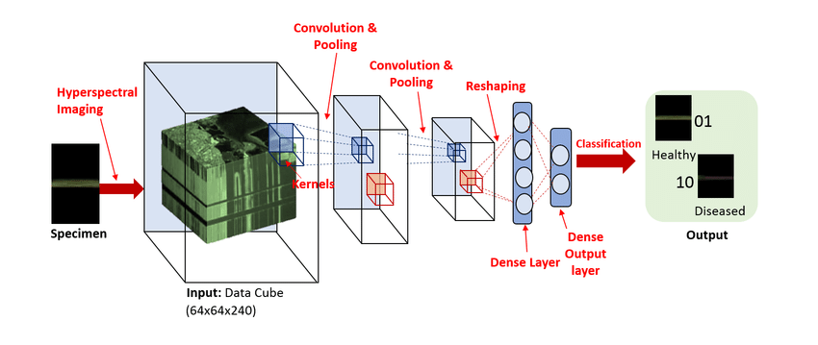
Why 3D CNN
Key Applications: 3D CNNs are especially effective for:
Video analysis
Medical imaging (e.g., MRI, CT scans)
Human activity recognition
Any task requiring spatial and temporal
context

Slide 26
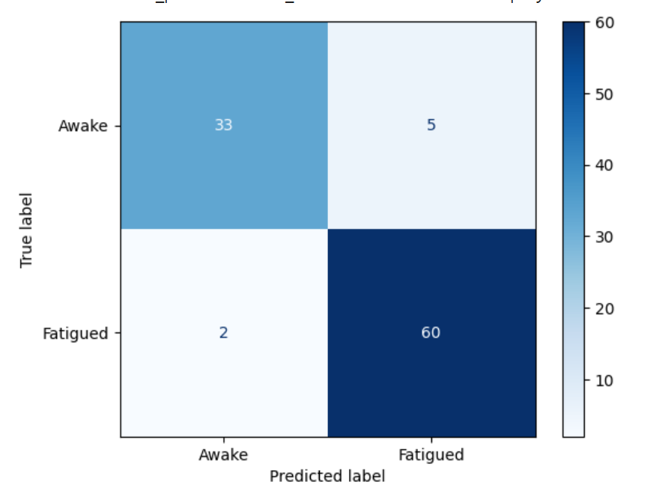
CONFUSION MATRIX FOR BINARY CLASSIFICATION:

Slide 27
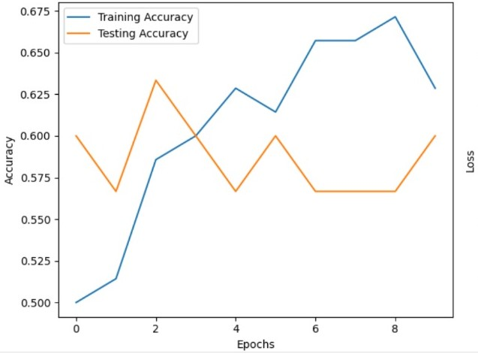
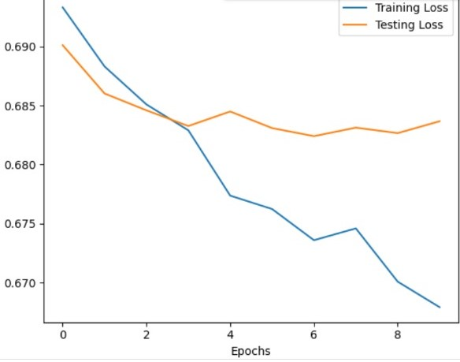
3D CNN:
Training Accuracy and Testing Accuracy: Training Loss and Testing Loss:

Slide 28
CONFUSION MATRIX:

Slide 29

Publication Paper:

Slide 30
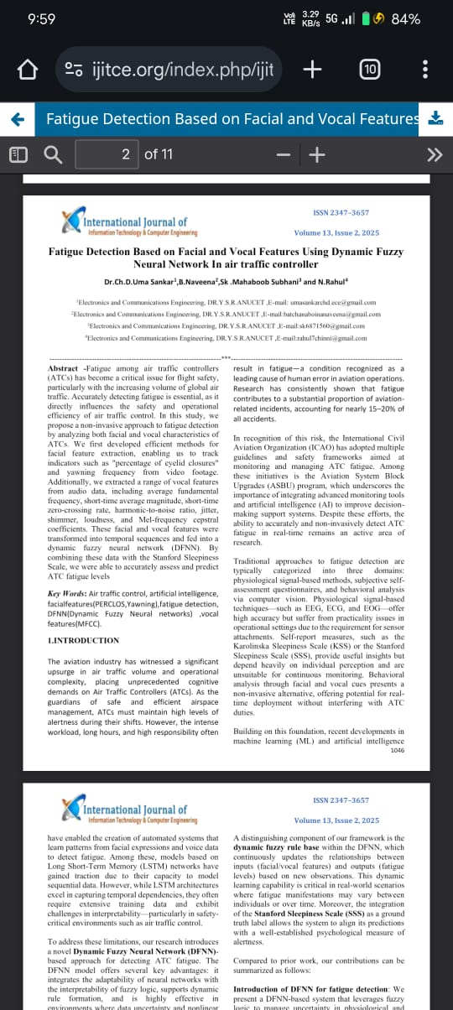
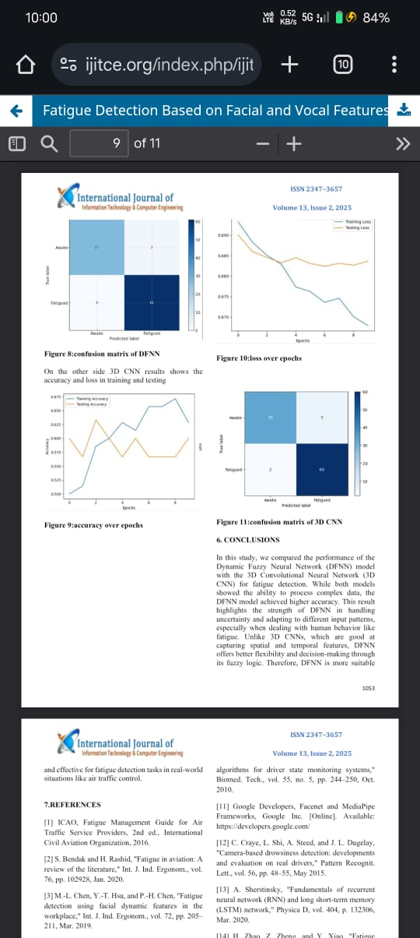

Slide 31
CONCLUSION:
In this study, we compared the performance of the Dynamic Fuzzy Neural Network (DFNN) model with the 3D Convolutional Neural Network (3D CNN) for fatigue detection. While both models showed the ability to process complex data, the DFNN model achieved higher accuracy. This result highlights the strength of DFNN in handling uncertainty and adapting to different input patterns, especially when dealing with human behavior like fatigue. Unlike 3D CNNs, which are good at capturing spatial and temporal features, DFNN offers better flexibility and decision-making through its fuzzy logic. Therefore, DFNN is more suitable and effective for fatigue detection tasks in real-world situations like air traffic control.

Slide 32
FUTURE SCOPE:
DFNN models can be deployed in air traffic control rooms, pilot cabins, military operations,a
and nuclear plants for real-time fatigue monitoring, helping prevent human error and accidents.
DFNN models can be integrated into smart glasses, headsets, or smartphones to continuously monitor eye and voice patterns, enabling on-the-go fatigue detection for workers, drivers, or students.
Future systems can combine DFNN with IoT devices and cloud computing to collect and process data remotely, allowing centralized monitoring of fatigue across multiple users or locations.
DFNNs can be combined with other AI models like LSTM, CNN, or transformers to improve detection of complex fatigue signs through multi-modal analysis (facial + audio + behavioral).

Slide 33
THANK YOU

